Slide 1

6th Grade Accelerated Math
Unit 10, Lesson 4 Determining Appropriate Measures of Center and Variation Volume 2, pg. 122

Slide 2


Benchmark
MA.7.DP.1.1
Determine an appropriate measure of center or measure of variation to summarize numerical data, represented numerically or graphically, while taking into consideration the context and any outliers.
volume 2, pg. 122

Slide 3
Integrated Mathematical Thinking and Reasoning Standards
MA.K12.MTR.2.1 Demonstrate understanding by representing problems in multiple ways.
MA.K12.MTR.7.1 Apply mathematics to real-world contexts.
volume 2, pg. 122

Slide 4

Learning Target
I can determine an appropriate measure of center and variation to summarize numerical data.
volume 2, pg. 122

Slide 5

Warm-Up
volume 2, pg. 123

Slide 6
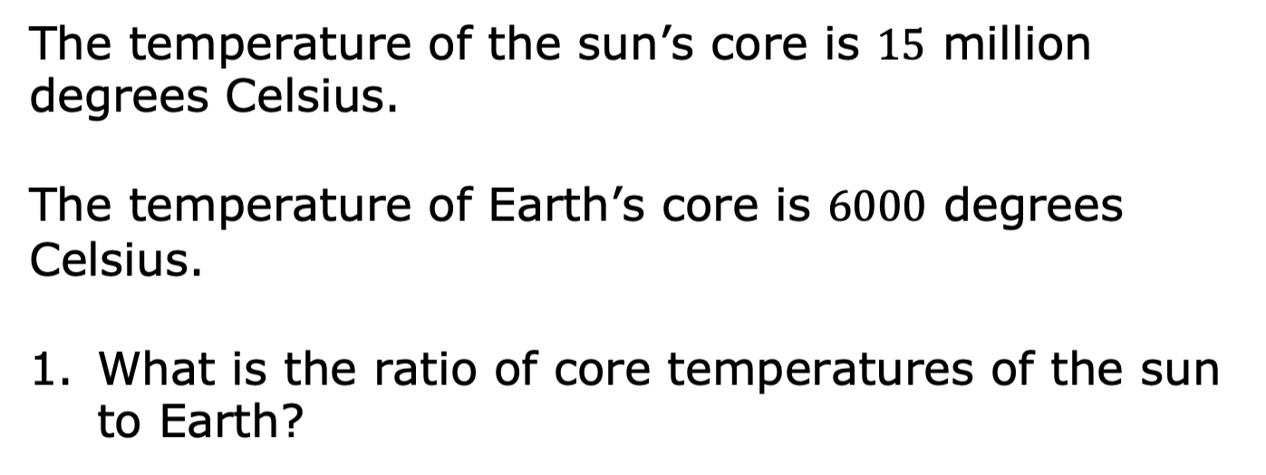
10.4.1 Warm-Up: Between Two Numbers
volume 2, pg. 123

Slide 7

Guided Practice
volume 2, pg. 123

Slide 8

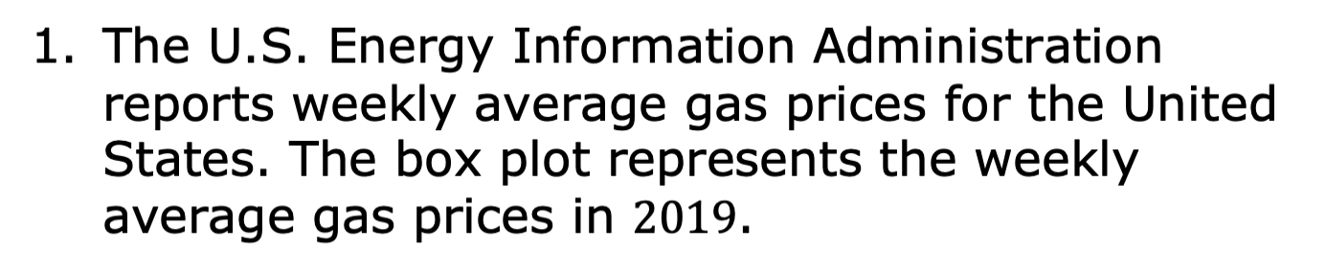
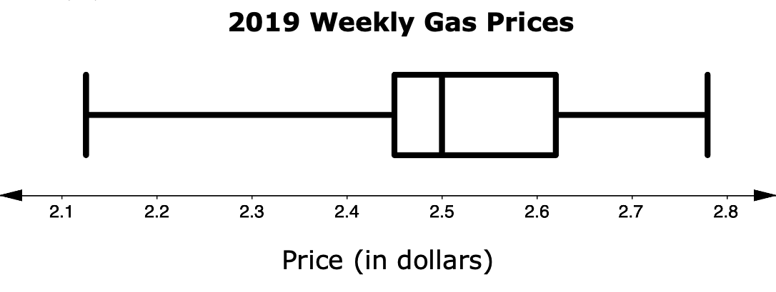
10.4.2 Guided Practice: Measures of Center and Variation
volume 2, pg. 123

Slide 9
Explain which measure of center, the mean or the median, best describes the center of the data.
If possible, find the value of the measure you chose in Part A.
volume 2, pg. 123

Slide 10
Describe the variation of the weekly average price of gasoline.
Given your description, does the interquartile range or range better represent the variation in price?
volume 2, pg. 124

Slide 11
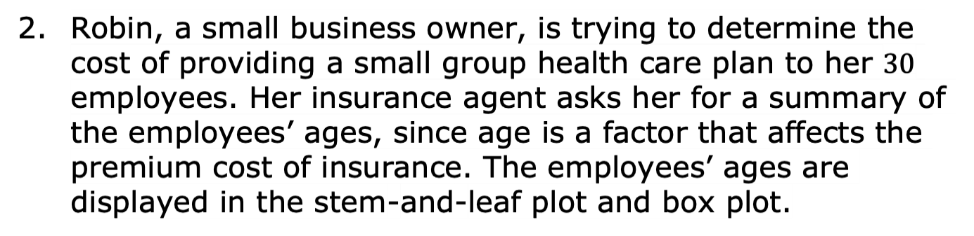
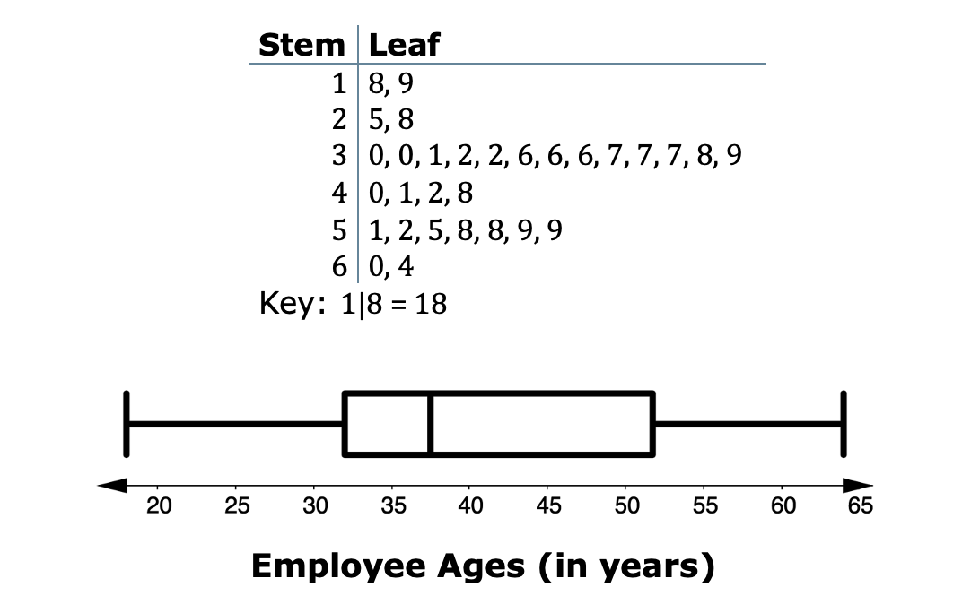
volume 2, pg. 124

Slide 12
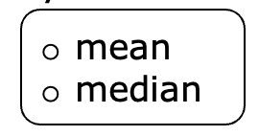
Complete the statements to explain which measure of center and variation Robin should provide to her insurance agent to accurately summarize the ages of her employees.
The best summarizes the center of
the data for the agent because …
volume 2, pg. 124

Slide 13
IQR
range
The best summarizes the
variation of the data for the agent because …
volume 2, pg. 125

Slide 14

Try It
volume 2, pg. 125

Slide 15

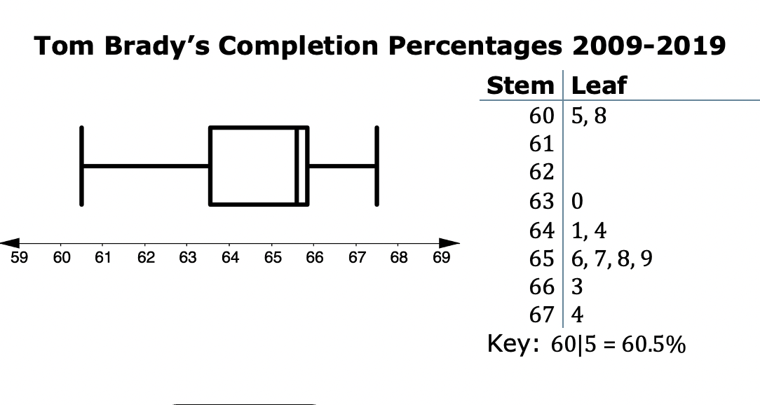
10.4.3 Try It: Measures of Center and Variation
Tom Brady is considered by most to be one of the best NFL quarterbacks of all time. His pass-completion percentages from 2009 to 2019 are shown in the box plot and stem-and-leaf plot.
volume 2, pg. 125

Slide 16
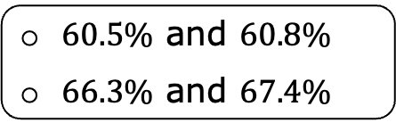
mean
median
The best summarizes the center of
the data. The is not the best measure
of center because it is influenced by the values
that are far from the rest of
the data values.
mean
median
volume 2, pg. 125

Slide 17
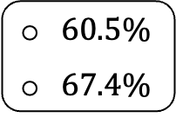
IQR
range
b. The best summarizes the variation of
the data. The is not the best measure
of variation because it is affected by the value
that is far from the rest of the data.
IQR
range
volume 2, pg. 125

Slide 18
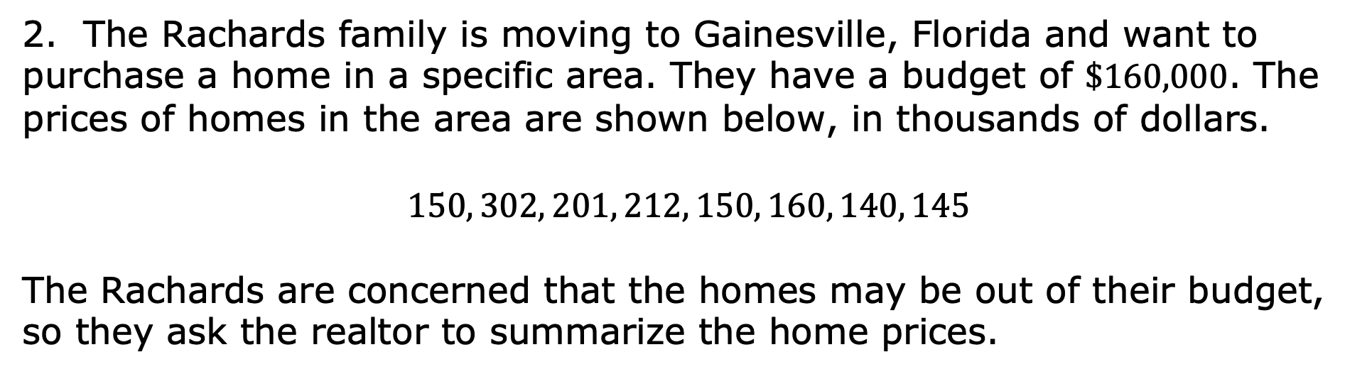
2. The Rachards family is moving to Gainesville, Florida and want to purchase a home in a specific area. They have a budget of $\$160,000$. The prices of homes in the area are shown below, in thousands of dollars.
$$150, 302, 201, 212, 150, 160, 140, 145$$
The Rachards are concerned that the homes may be out of their budget, so they ask the realtor to summarize the home prices.
volume 2, pg. 126

Slide 19
Which measure of center should the realtor report to the Rachards, the mean or the median? Explain your reasoning.
Which measure of variation should the realtor report to the Rachards, the interquartile range or the range? Explain your reasoning.
volume 2, pg. 126

Slide 20

Your Turn
volume 2, pg. 126

Slide 21
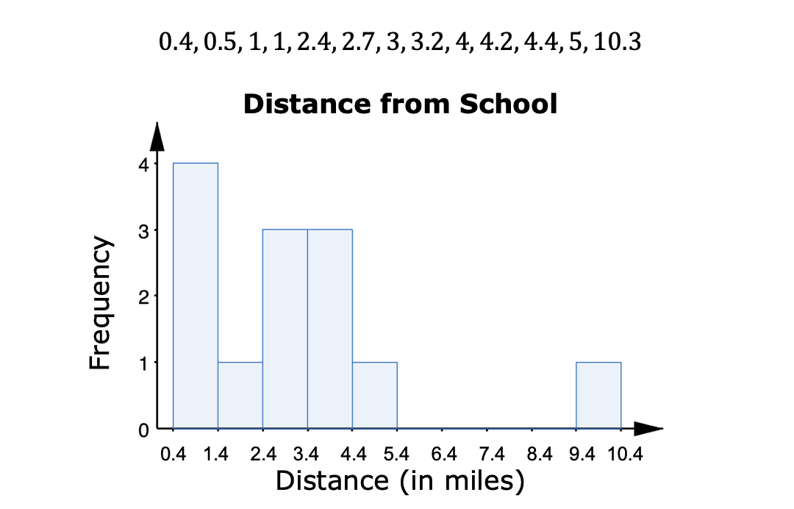
10.4.4 Your Turn!
Zane and $12$ of his friends listed how far, in miles, they live from the school and created a histogram.
volume 2, pg. 126

Slide 22
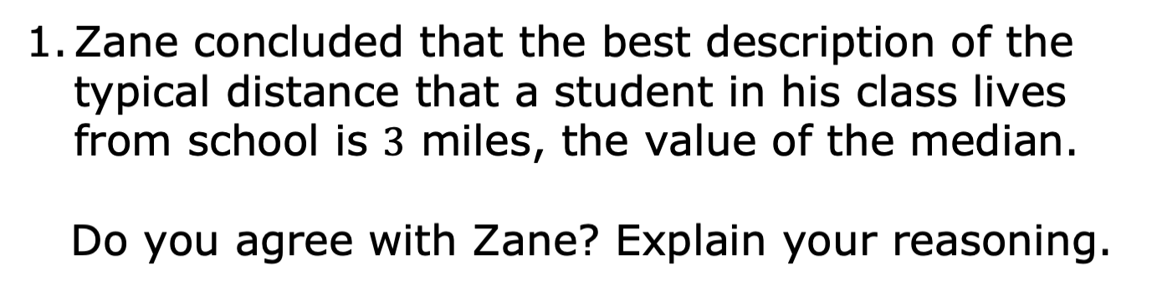
volume 2, pg. 126

Slide 23
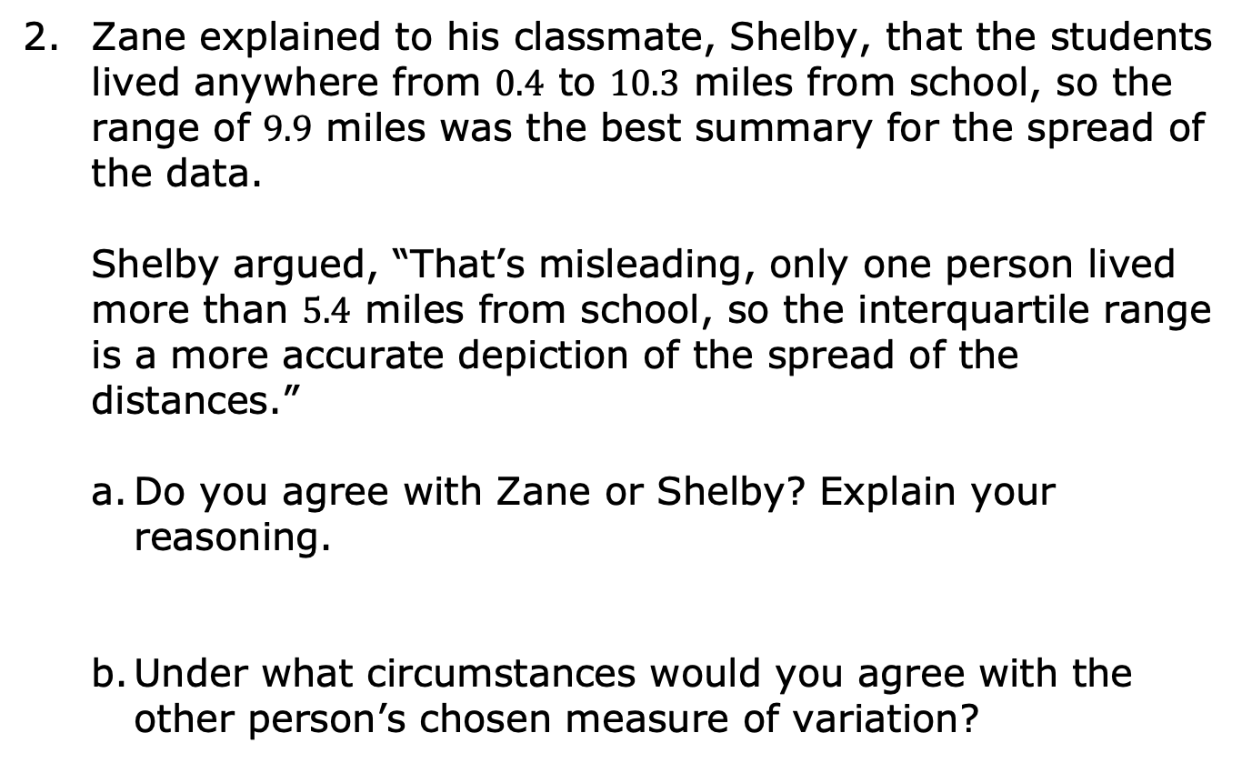
volume 2, pg. 127

Slide 24
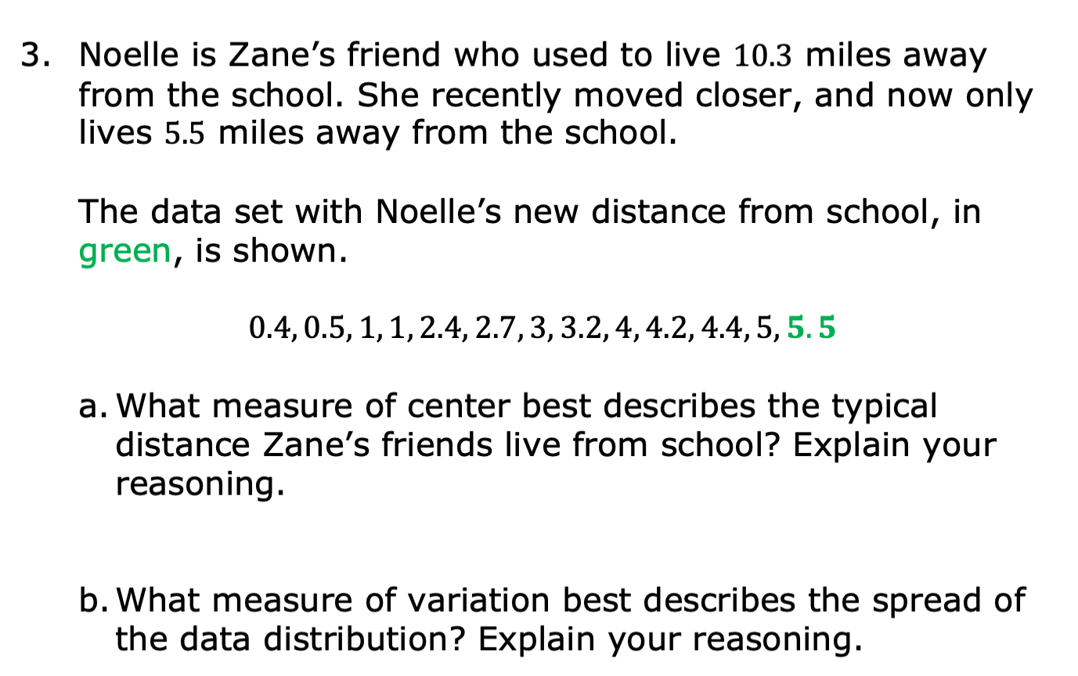
volume 2, pg. 127

Slide 25

Wrap-Up
volume 2, pg. 128

Slide 26
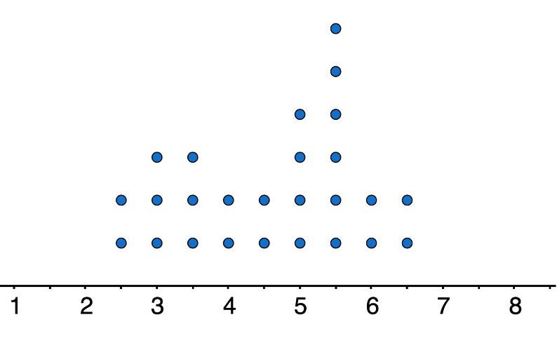
10.4.5 Wrap-Up: Ticket Out the Door
The dot plot summarizes the hours of battery life for students’ cell phones when streaming videos.
Battery Life (in hours)
volume 2, pg. 128

Slide 27
Mr. Funk’s world history class has an upcoming field trip to Tallahassee, Florida that involves a five-hour drive. The students want to be able to watch videos on their phones during the drive without charging their cell phones.
Determine the appropriate measure of center and variation for the battery life of the students’ cell phones when streaming videos.
volume 2, pg. 128

